Slide 1
AI Application and Ethics in AI Session 25
Course : COMP6065001 Artificial Intelligence
Effective Period : September 2023

Slide 2
Learning Outcomes
At the end of this session, students will be able to:
LO 1: Describe what is AI and identify concept of intelligent agent
LO 2: Explain various intelligent search algorithms to solve the problems
LO 3: Explain how to use knowledge representation in reasoning purpose
LO 4: Apply various techniques to an agent when acting under certainty
LO 5: Explain Ethics in Artificial Intelligence

Slide 3
Outline
Task Domains of AI
AI Application
AI Application (Student Projects)
What is Ethics?
The Ethics of Artificial Intelligence
Best Practice

Slide 4
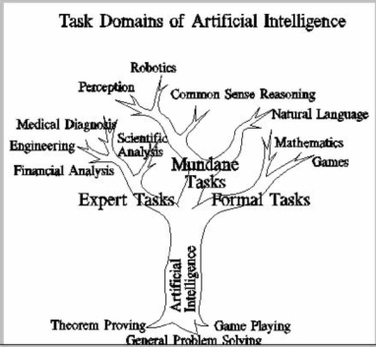
Task Domains of AI
According to Rich, Knight, & Nair (2010), task domains of AI can be described using the following figure.

Slide 5
Task Domains of AI
Mundane Tasks | Formal Tasks | Expert Tasks
Perception | Games | Engineering
Vision | Chess | Design
Speech | Mathematics | Fault Finding
Natural Language | Geometry | Manufacturing Planning
Understanding | Logic | Scientific Analysis
Generation | Integral Calculus | Medical Analysis
Translation | Theorem Proving | Financial Analysis
Commonsense Reasoning
Robot Control

Slide 6
Artificial Intelligence: Branching by Application

Slide 7
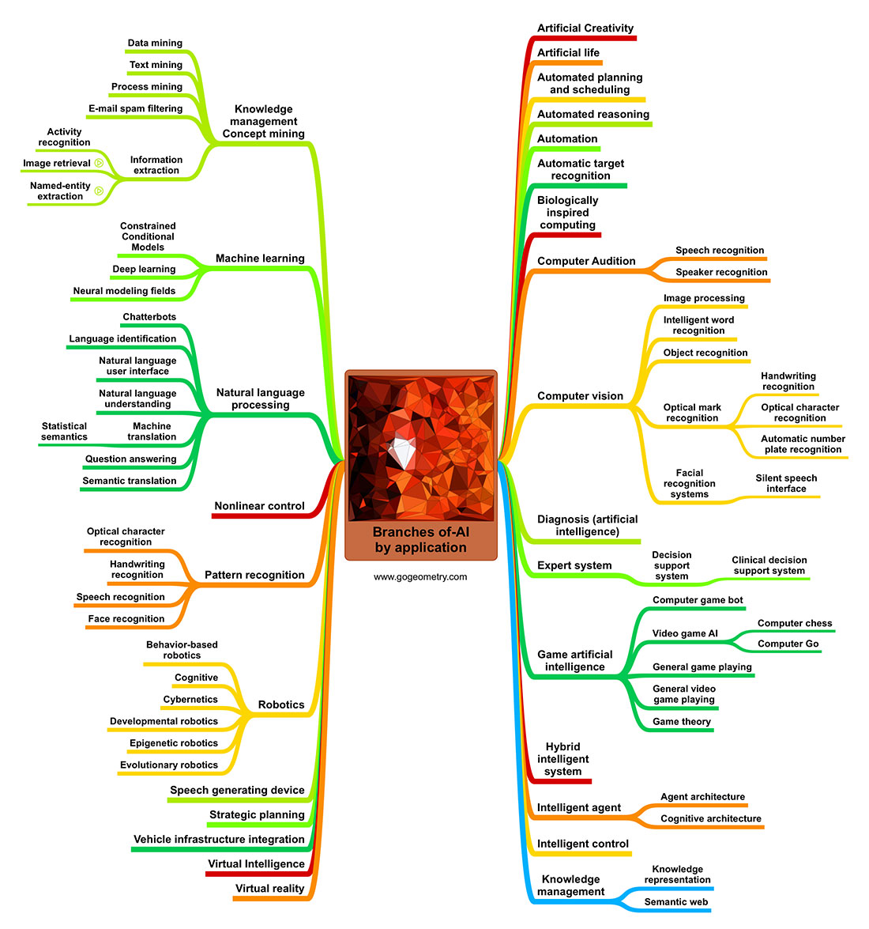
Artificial Intelligence Branch

Slide 8
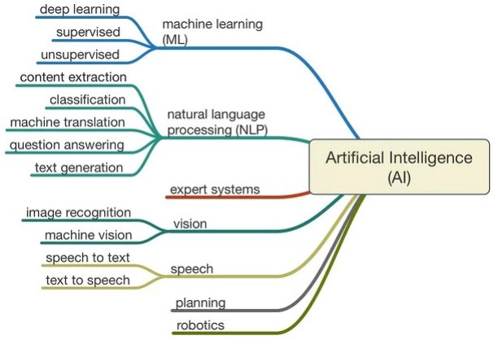

Slide 9
Several AI Real World Application

Slide 10
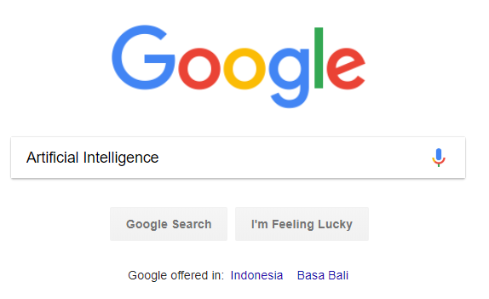
AI Application
Search Engines

Slide 11
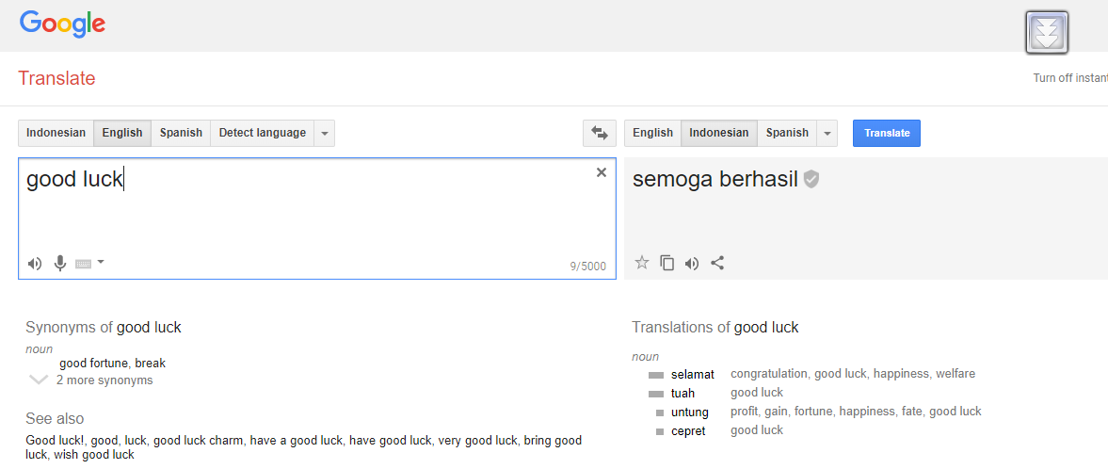
AI Application
Machine Translations

Slide 12
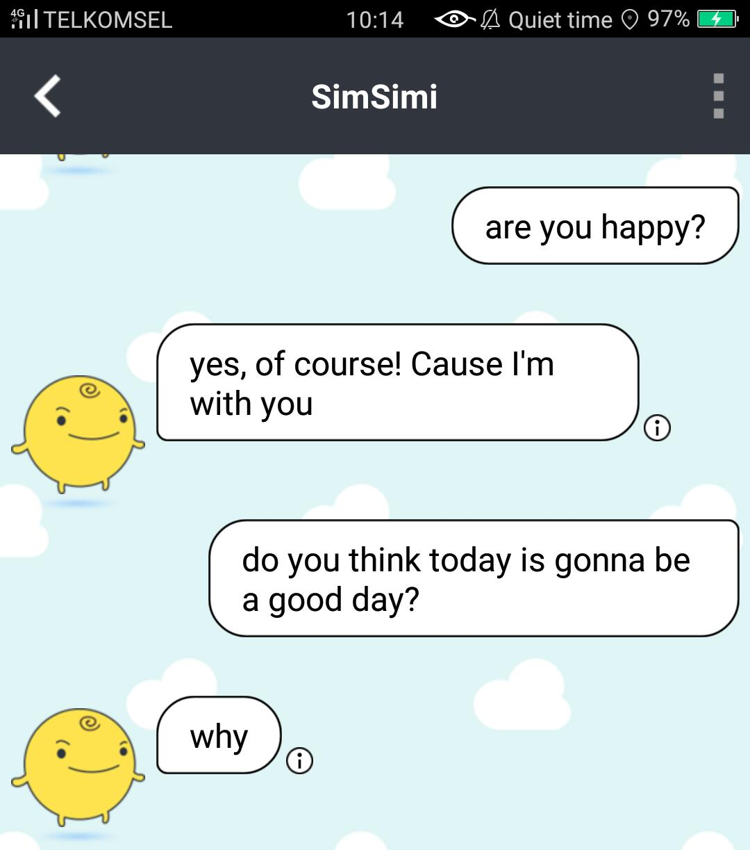
AI Application
Chatbots

Slide 13
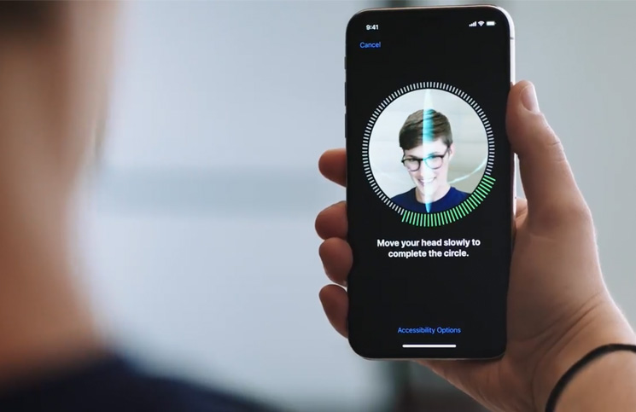
AI Application
Face Recognition – For Security Purpose (Phone Lock)

Slide 14
AI Application (Student Projects)

Slide 15
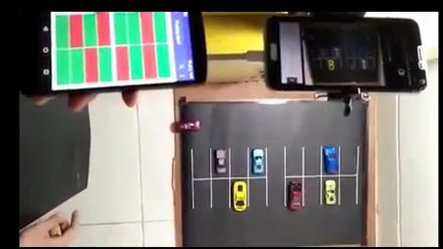
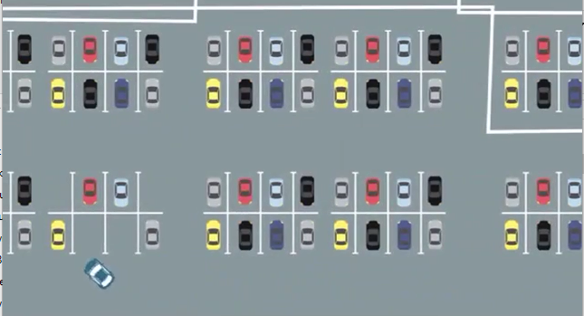
AI Application (Student Projects)
Parking Spot - https://www.youtube.com/watch?v=s2LRec3iR3o
This project is done by Binusian 2019 Computer Science
AI: Computer Vision to detect the cars and available parking spot

Slide 16
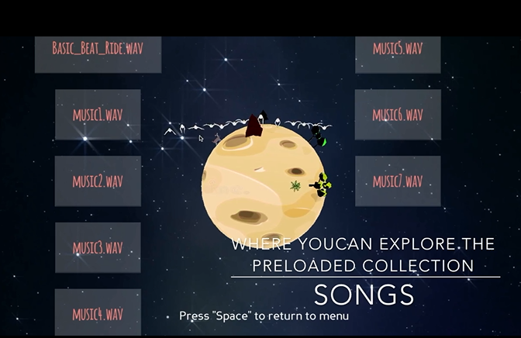
AI Application (Student Projects)
Astro Rhytm - https://www.youtube.com/watch?v=aVE6f1H_zH4
This project is done by Binusian 2019 Computer Science
AI: Detecting tones and rythms

Slide 17
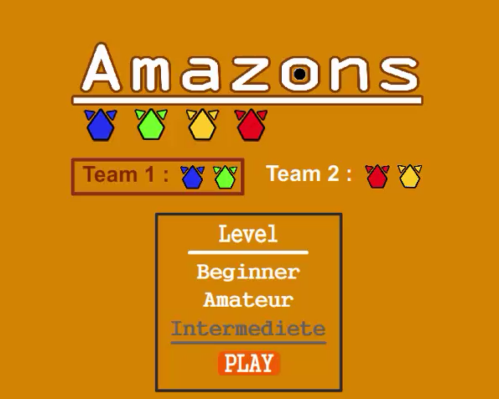
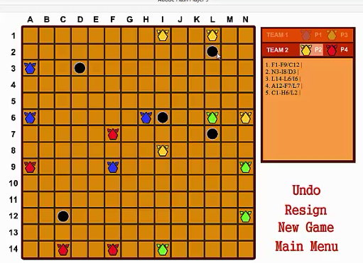
AI Application (Student Projects)
Amazon - https://goo.gl/oLvgRV
This project is done by Binusian 2018 Computer Science
AI: Searching Algorithm for Game movement

Slide 18
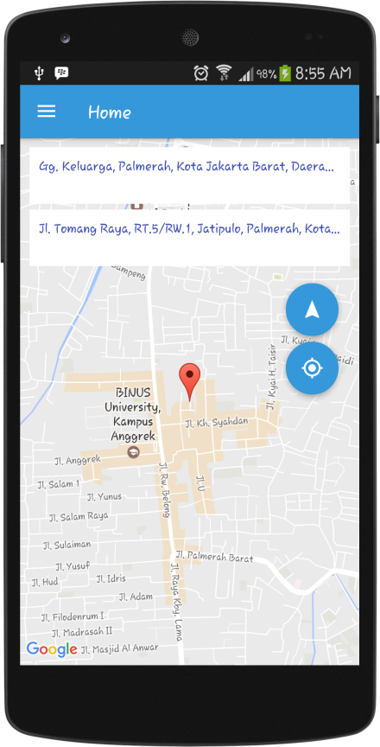
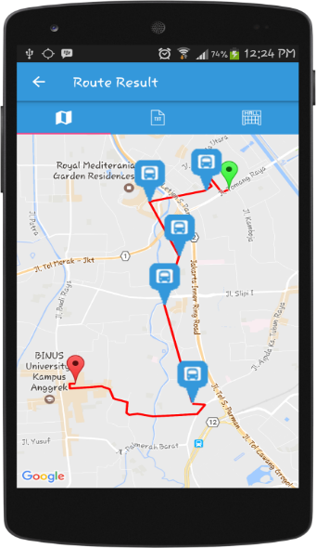
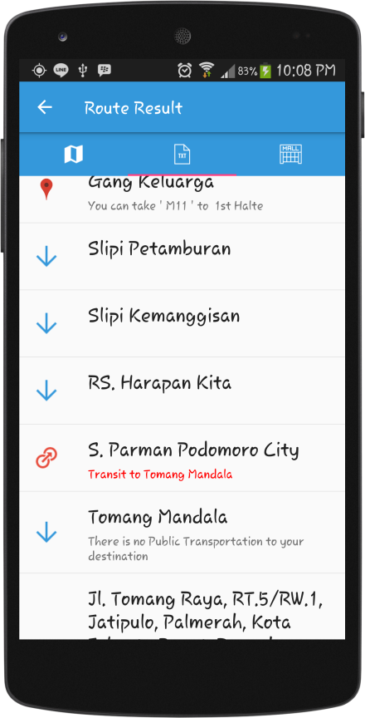
AI Application (Student Projects)
TransTrip - https://goo.gl/8VyVeH
This project is done by Binusian 2017 Computer Science
AI: the use of path finding (search algorithm)

Slide 19
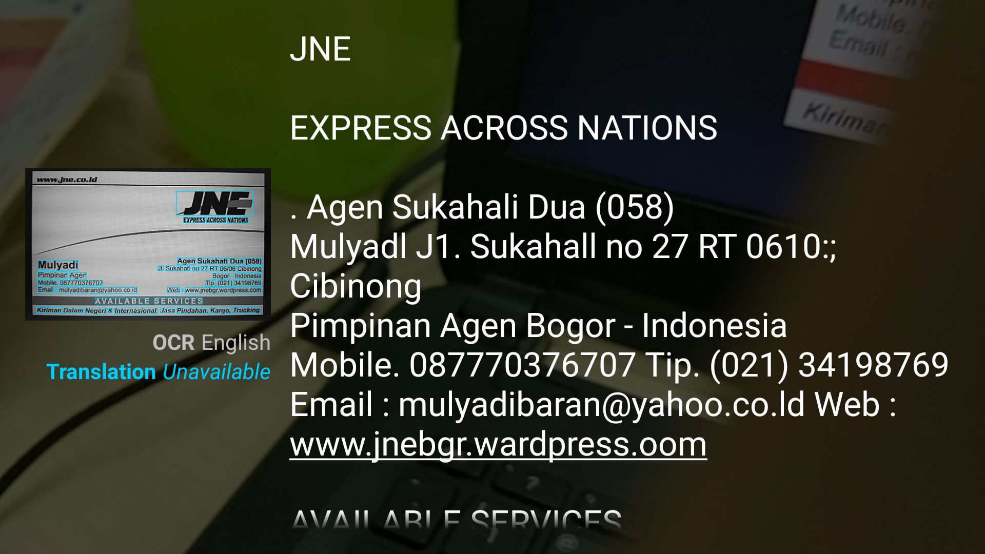
AI Application (Student Projects)
OCR for Business Card
This project is done by Binusian 2019 Computer Science
AI: Convert Image to Text

Slide 20
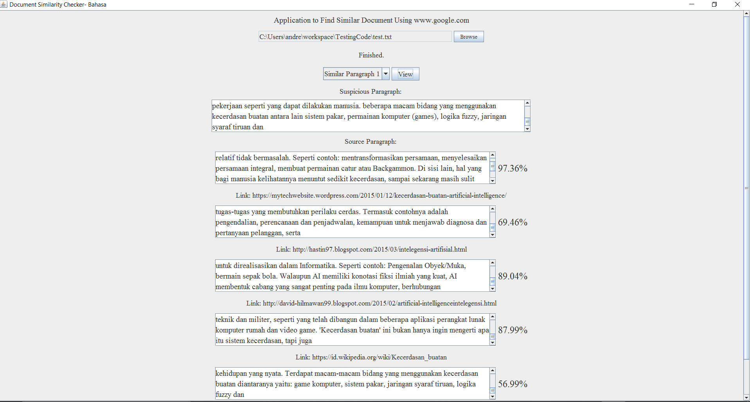
AI Application (Student Projects)
Plagiarism Checker
This project is done by Binusian 2017 Computer Science
AI: NLP to check document similarity

Slide 21
Ethics in Artificial Intelligence

Slide 22
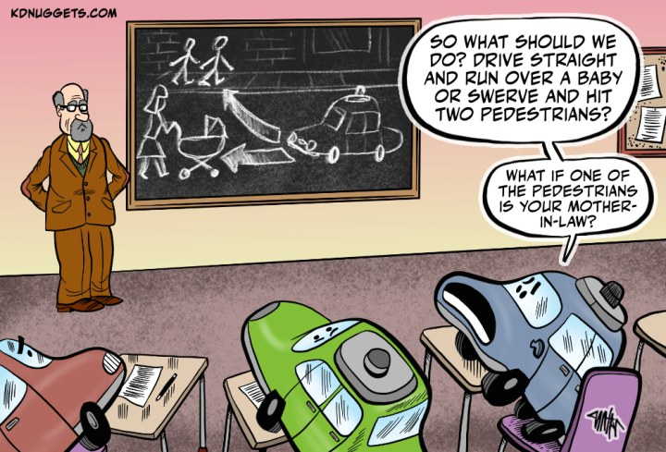
Source: https://www.kdnuggets.com/2020/01/cartoon-teaching-ethics-ai.html
Notes:
Notes to Lecturer: create a joke about this picture before move on to next slide

Slide 23
What is Ethics?
Notes:
Notes to lectures: Give students time to answer this question at least (5-10 minutes)

Slide 24
Ethics
Ethics ≠ Feelings
Ethics ≠ Laws
Ethics ≠ Societal Beliefs
Source: https://www.scu.edu/ethics/ethics-resources/ethical-decision-making/what-is-ethics/
Notes:
Notes to lecturer: express your opinion about ethics and why do you think ethics is not feeling, societal beliefs and laws

Slide 25
Ethical Theories
Divine Command:
Moral behaviors are those commanded by the divine
Criticism: not much philosophy can say
Virtue Ethics:
Moral behaviors uphold the person’s virtues
Criticism: increasing evidence that character traits are illusory
Deontology (Duty)
Moral behaviors are those that satisfy the categorical imperative (e.g. don’t lie, don't kill)
Criticism: unacceptable inflexibility
Utilitarianism
Moral behaviors are those that bring the most good to the most people
Criticism: How to measure utility?

Slide 26
Triggering Question
Notes:
Notes to lectures: Give students time to answer this question at least (5-10 minutes)

Slide 27
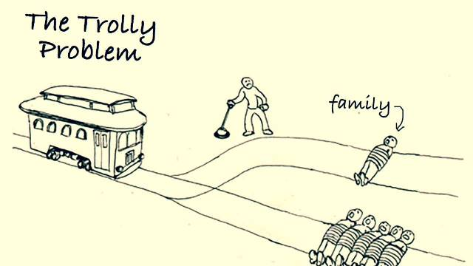
Source: https://www.pojokseni.com/2021/06/the-trolley-problem-gesekan-antara.html
Notes:
Lectures gives a triggering question regarding about the trolly problem. (Let student answer first and assess the activity) give (5-10 minutes to let them answer this question) after that give your opinion about the trolley problem

Slide 28
The Ethics of Artificial Intelligence
Notes:
Notes to lectures: Give students time to answer this question at least (5-10 minutes)

Slide 29
Case Study about Ethical AI:
In future, a bank using a machine learning algorithm to recommend mortgage applications for approval.
Here is the problem:
A rejected applicant brings a lawsuit against the bank, alleging that the algorithm is discriminating racially against mortgage applicants.
The bank replies that this is impossible, since the algorithm is deliberately blinded to the race of the applicants
statistics show that the bank’s approval rate for black applicants has been steadily dropping.
Submitting ten apparently equally qualified genuine applicants (as determined by a separate panel of human judges) shows that the algorithm accepts white applicants and rejects black applicants.
What do you think about this kind of problem?
Notes:
Let students think what is the right answer?

Slide 30
Fundamental Question in Ethical AI
Does the future of AI pose an existential threat to humanity?
How do we prevent learning algorithms from acquiring morally objectionable biases?
Should autonomous AI be used to kill in warfare?
How should AI systems be embedded in our social relations? Is it permissible to fall in love with an AI system?
What sort of ethical rules should AI like a self-driving car use?
Can AI systems suffer moral harms? And if so, of what kinds?
Can AI systems be moral agents? If so, how should we hold them accountable?

Slide 31
The Positive and The Negative Impact of AI
The Positive
The Negative
Medical Discovery
Improved medical diagnosis
Safer driving with driver assistance or self-driving technology
Recovering from natural disaster
etc
Autonomous Weapon
Surveillance, security and privacy
Fairness and Bias
Trust and Transparency
Replacing Human Labor
Notes:
Lecture Notes: Explain about the moral dilemma in negative impact of AI; explain in term of example problem and what will happen if it becomes true

Slide 32

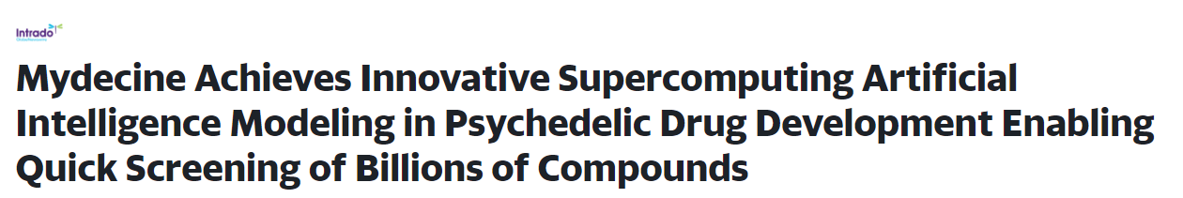
Several News about AI

Slide 33
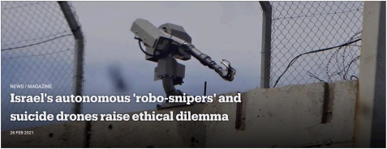

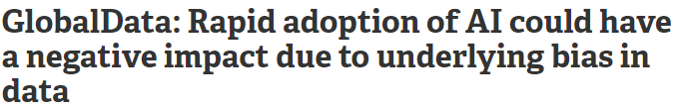
Several News about AI

Slide 34
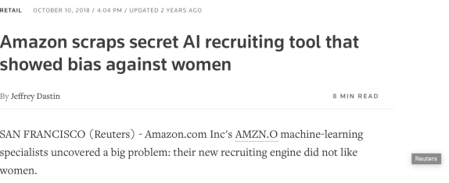

Several News about AI

Slide 35
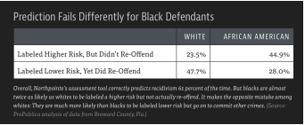
Several News about AI

Slide 36
Best Practice

Slide 37
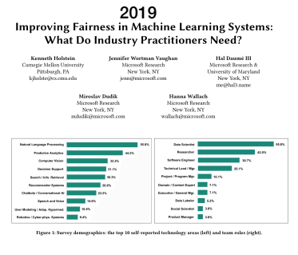
What do practitioners need?
Support in fairness-aware data collection and curation
Overcoming teams’ blind spots
Implementing more proactive fairness auditing process
Auditing complex ML System
Deciding how to address particular instances of unfairness
Addressing biases in the human embedded throughout the ML development pipelines

Slide 38
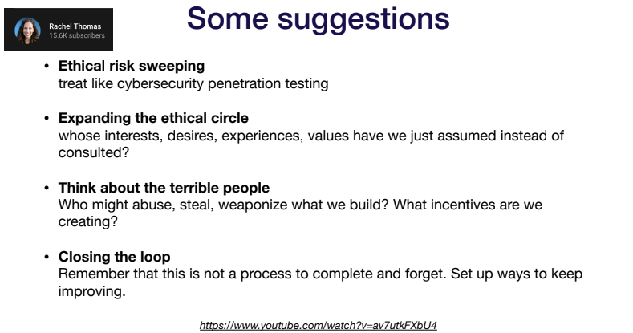

Slide 39
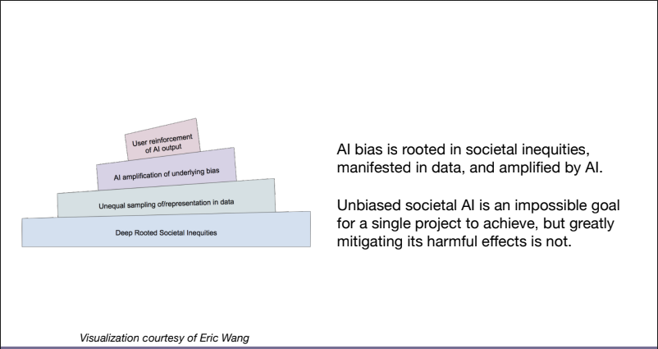

Slide 40
References
Stuart Russell, Peter Norvig. 2010. Artificial Intelligence : A Modern Approach. Pearson Education. New Jersey. ISBN:9780132071482
N. Bostrom and E. Yudkowsky. ‘The ethics of artifcial intelligence’. In W. M. Ramsey and K. Frankish, editors, The Cambridge Handbook of Artificial Intelligence, pages 316–334. Cambridge University Press, Cambridge, 2014.
Sergey Karagev, Josh Tobin, Pieter Abbeel, Ethics- Lecturer Notes: Full stack Deep Learning, University of California Berkeley Spring 2021.

Slide 41
References
Stuart Russell, Peter Norvig. 2010. Artificial Intelligence : A Modern Approach. Pearson Education. New Jersey. ISBN:9780132071482
Elaine Rich, Kevin Knight, Shivashankar B. Nair. (2010). Artificial intelligence. 03. McGraw Hill. New York. ISBN: 0070678162.

